Slide 1
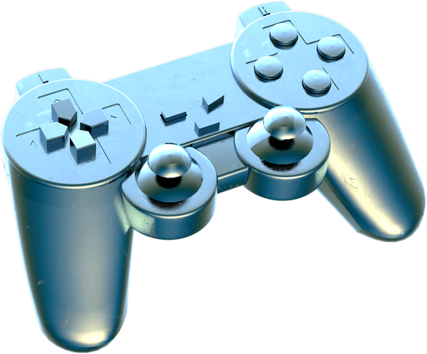
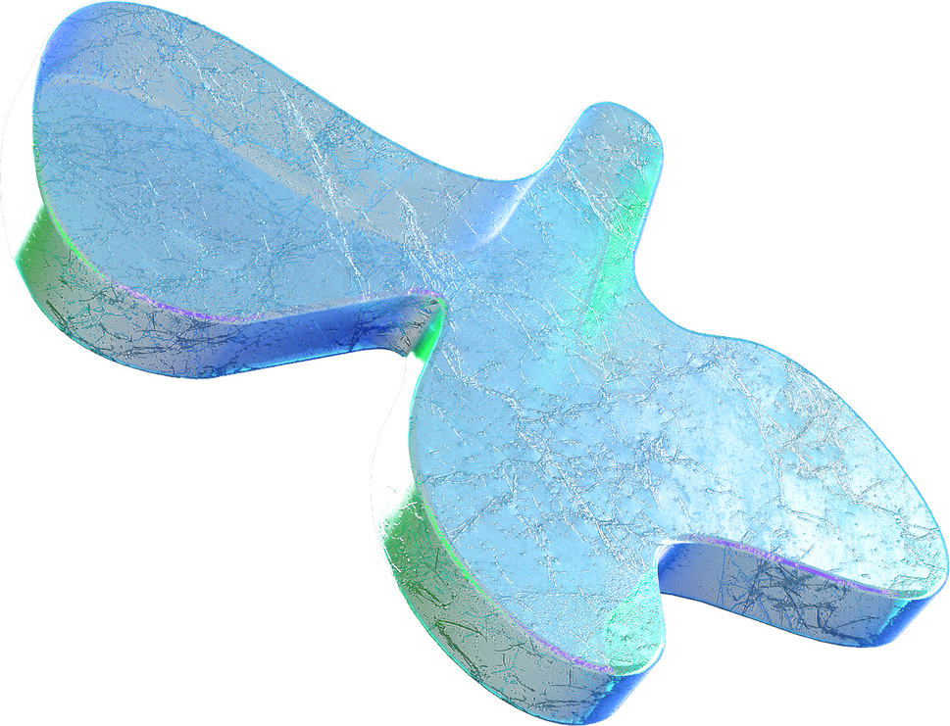
Refik Can OZTAS
IoT Security: An Offensive Case Study

Slide 2
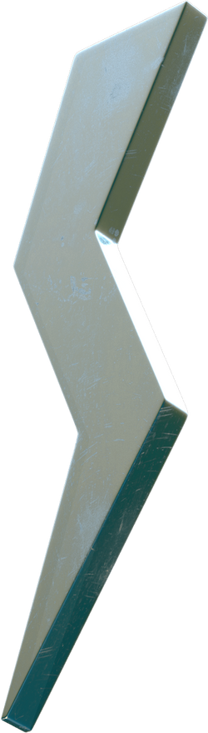
Introduction
IoT devices are starting to be used more day by day. Although these
devices are very useful even with their limited resources, their security is a
great attack vector. This paper covers and investigates several attacks on
real-life created IoT networks via hardwares to conduct those attacks.
Also, as the created network topology, future work directions are also
included in this paper
Methodology
Implementation
Related Works
Future Work Direction
Conclusion

Slide 3

Introduction
The need to secure the Internet of Things (IoT) is more important than ever
as the globe grows more interconnected due to the vast network of smart gadgets. IoT
technologies are expanding quickly, which presents a number of opportunities but also
raises a serious concern: these linked ecosystems are vulnerable to malevolent threats.
This case study explores the obstacles, tactics, and innovations in protecting the
confidentiality and integrity of connected devices, delving into the dynamic field of
IoT security.

Slide 4
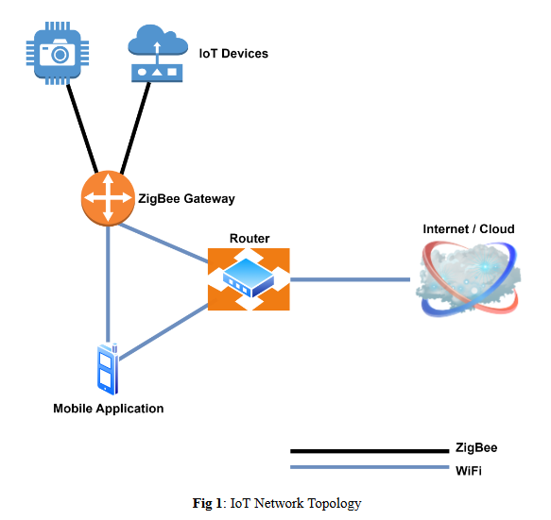
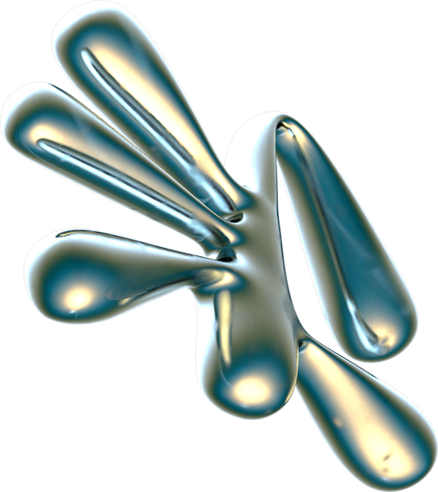
Methodology
Security of IoT devices
IoT network architecture
Network
Web (Front & Backend and Web services)
Mobile App (Android & iOS applications)
Wireless Connectivity (Zigbee, WiFi, Bluetooth, etc)
Firmware Security (OS of IoT Devices)
Hardware Hacking & Fault Injections & SCA Attacks
Storage Medium
I/O Ports

Slide 5
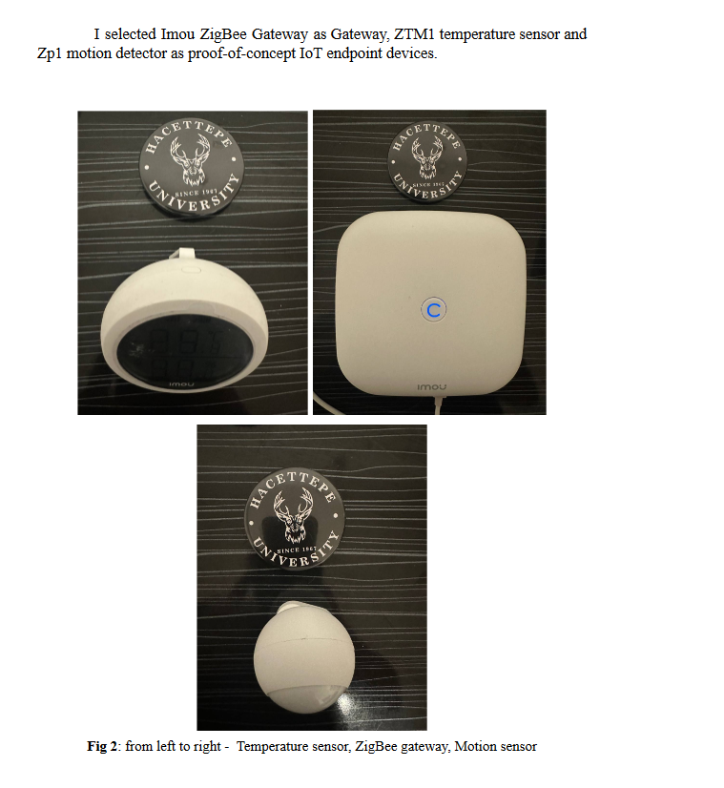
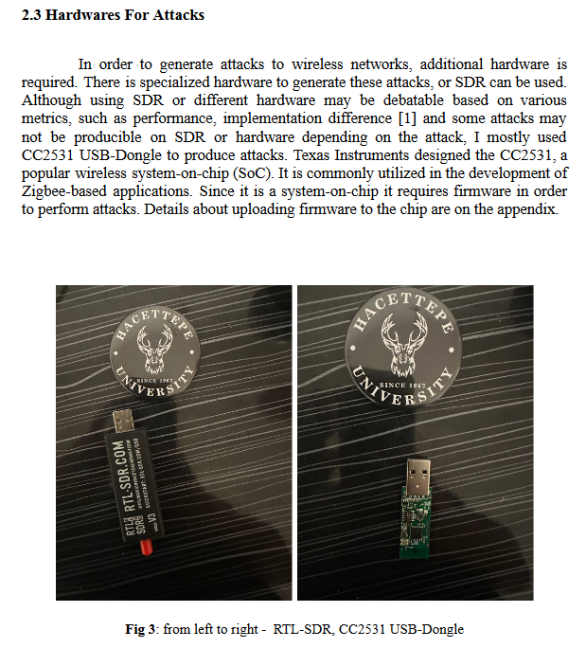
Methodology
Hardwares For Attacks
IoT devices

Slide 6
Implementation
ZIGBEE CHANNEL FUZZING
SCANNING
PACKET INJECTION
MANIPULATLION
OTHER COMPONENT FINDINGS
NETWORK SNIFFING

Slide 7
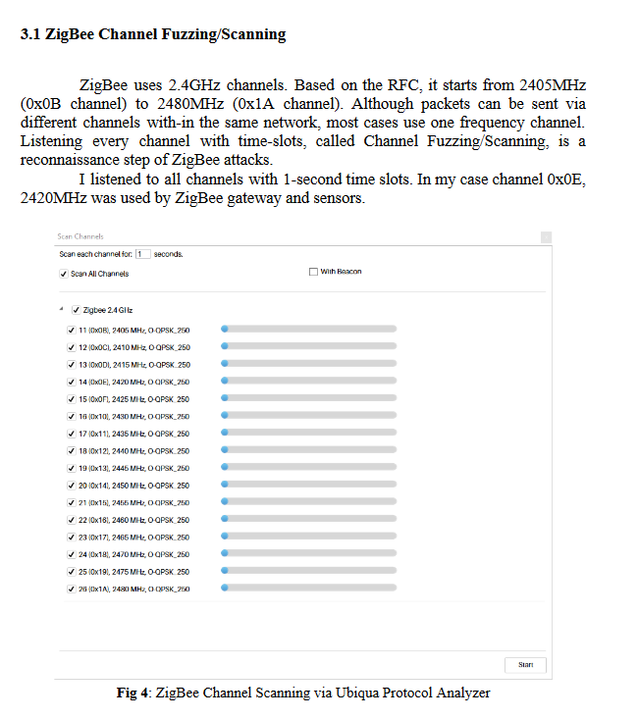
Implementation

Slide 8
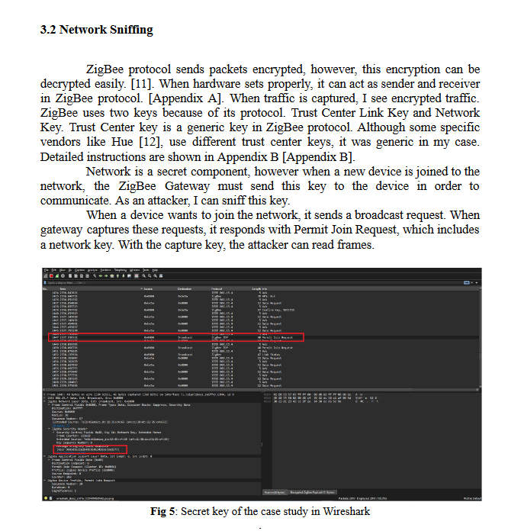
Implementation

Slide 9
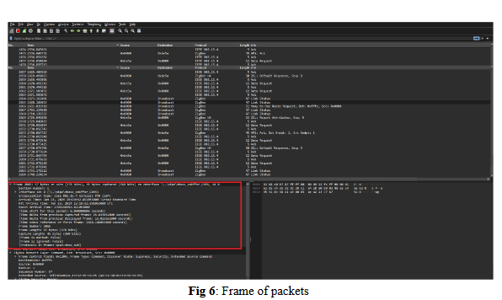
Implementation

Slide 10
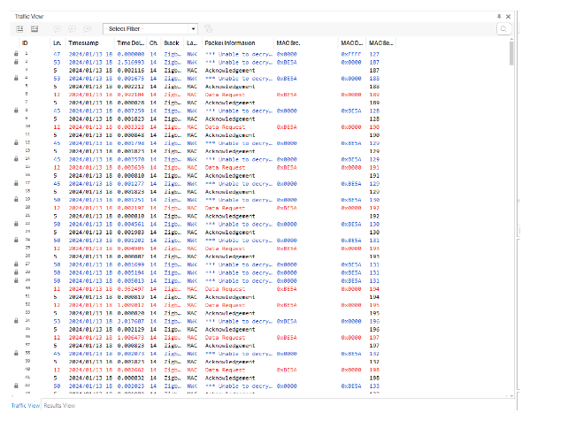
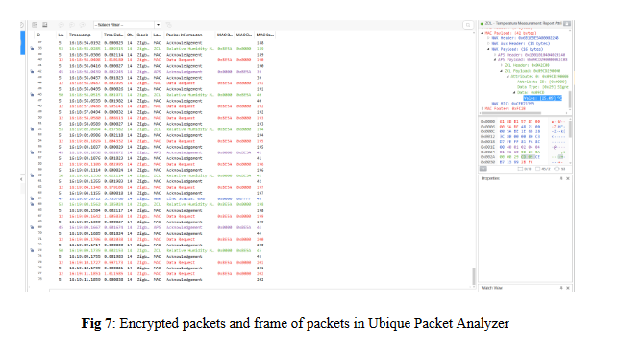
Implementation

Slide 11
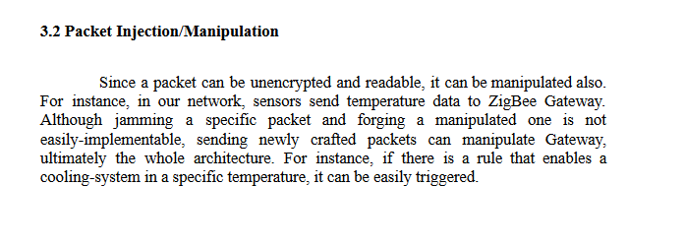
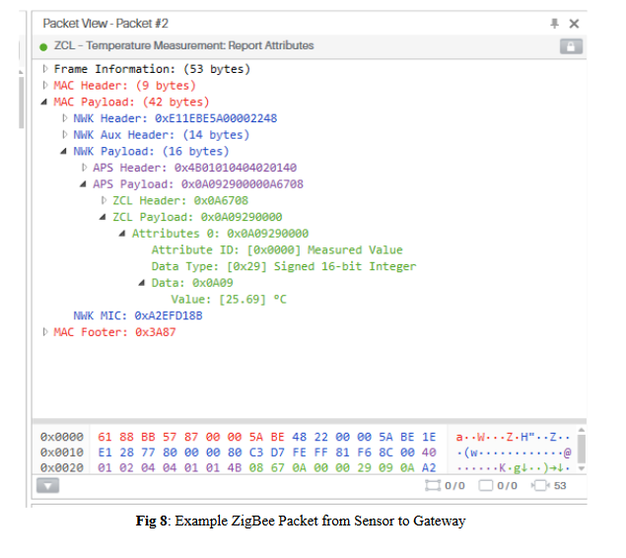
Implementation

Slide 12
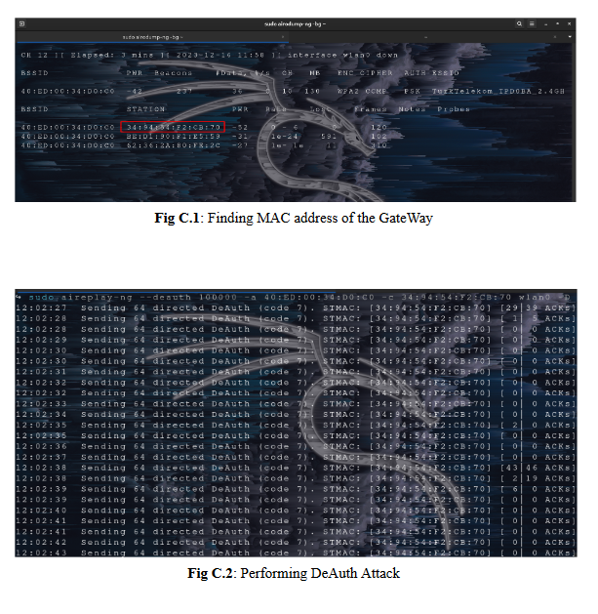
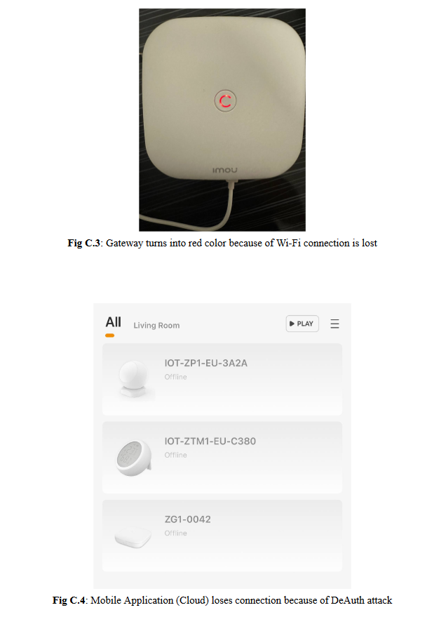
Implementation

Slide 13
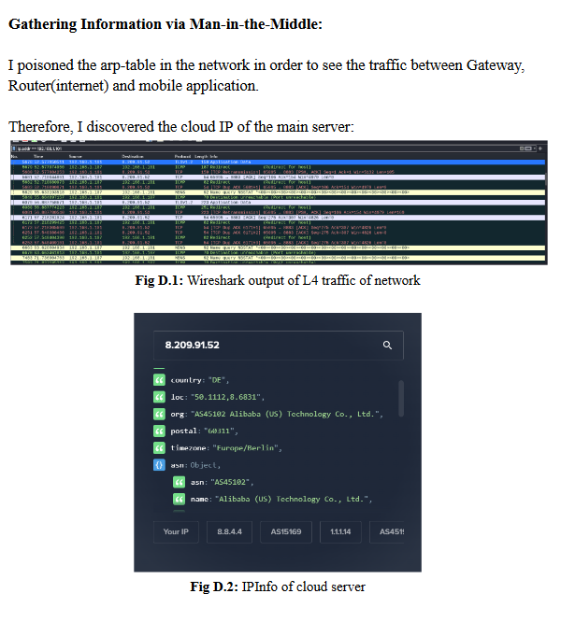
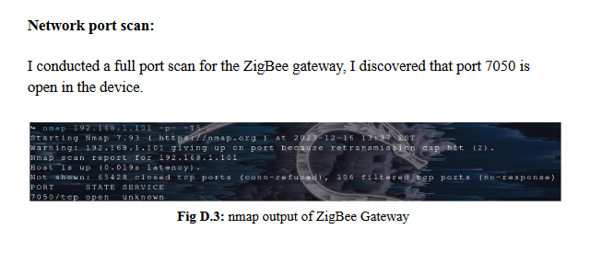
Implementation

Slide 14
Future Work Direction
● Since there is a PoC network and architecture for ZigBee, a dataset can be
created from real ZigBee traffic.
● Based on this traffic, implemented attacks can be generated in the traffic.
And, study for solving anomaly detection problems, classification of attack
problems can be conducted via Machine Learning / Artificial Intelligence /
Neural Network based approaches.
● Although this paper covers mostly wireless attacks of IoT devices, other
security components might be studied as a case study.
● Based on the traffic, IPS/IDS systems can be formed.
● With a proper IDS/IPS system, if hardware of devices is also studied, there
can be Endpoint Based Security Solutions for such systems.
● In addition, as a deep-dive security approach, vulnerabilities on ZigBee
protocol, or physically attack vectors (such as jamming with SDR) could be
studied and analyzed.
My case study required comparison and merging of various attacks on the
Wireless Security side of IoT devices. Based on this general study, future direction on
this research might be:

Slide 15
Conclusion
My research is a basic security case study on IoT devices. This research
starts with definitions and IoT devices security of components. Although this paper
mostly covers the wireless security of IoT devices, other components security is also
mentioned. In order to conduct a case study, I created an IoT network with various
devices, made the configuration and set-up the hardware devices in order to conduct
ZigBee attacks.
As mentioned in future directions, this case study may be extended to
generate dataset, characterize dataset and furthermore. My generated ZigBee data (not
all) is referenced in Appendix E [Appendix E].
Although ZigBee is a cheap technology for low-resource devices, its security
in IoT seems problematic. Hong Kong CERT team published a security guideline [13]
to prevent attacks just like in this case study, however, since the area like IoT is very
vendor dependent, forming and conducting security principles may not be possible in
near future

Slide 16
